Slide 1
Automation Testing Tool

Slide 2
Context
Automation Testing Tool : Selenium
What Selenium can do
Selenium WebDriver
How to use Selenium WebDriver
Setup and instantiate Webdriver
Sample Test case Automation
Browser Actions
Navigation Actions
WebElement Actions
Find elements in Selenium
Select Elements By ID
Select Elements By Name
Select Elements By Link Text
Select Elements By Partial Link Text
Select Elements By Xpath
Finding Multiple Elements
Working with WebElements
Alerts
iFrames

Slide 3
Prerequisites
Manual Testing
Programming Fundamentals
Comments, Data Types, Modifiers, Variables, Operators, Control Flow, Conditional Statements, Loop Statements, Branching Statements, Array, ArrayList, Methods, Predefined methods, User defined methods, String Handling, IO Operations, and File HandlingException Handling,Object oriented programming, Inheritance, Polymorphism, Abstraction, Encapsulation
HTML Concepts
HTML Elements and Operations on Elements,Page, Edit Box, Text Area, Button Link, Drop down box,List box, Combo box, Check box, Radio button, Web table,Frame etc
Database Fundamentals

Slide 4
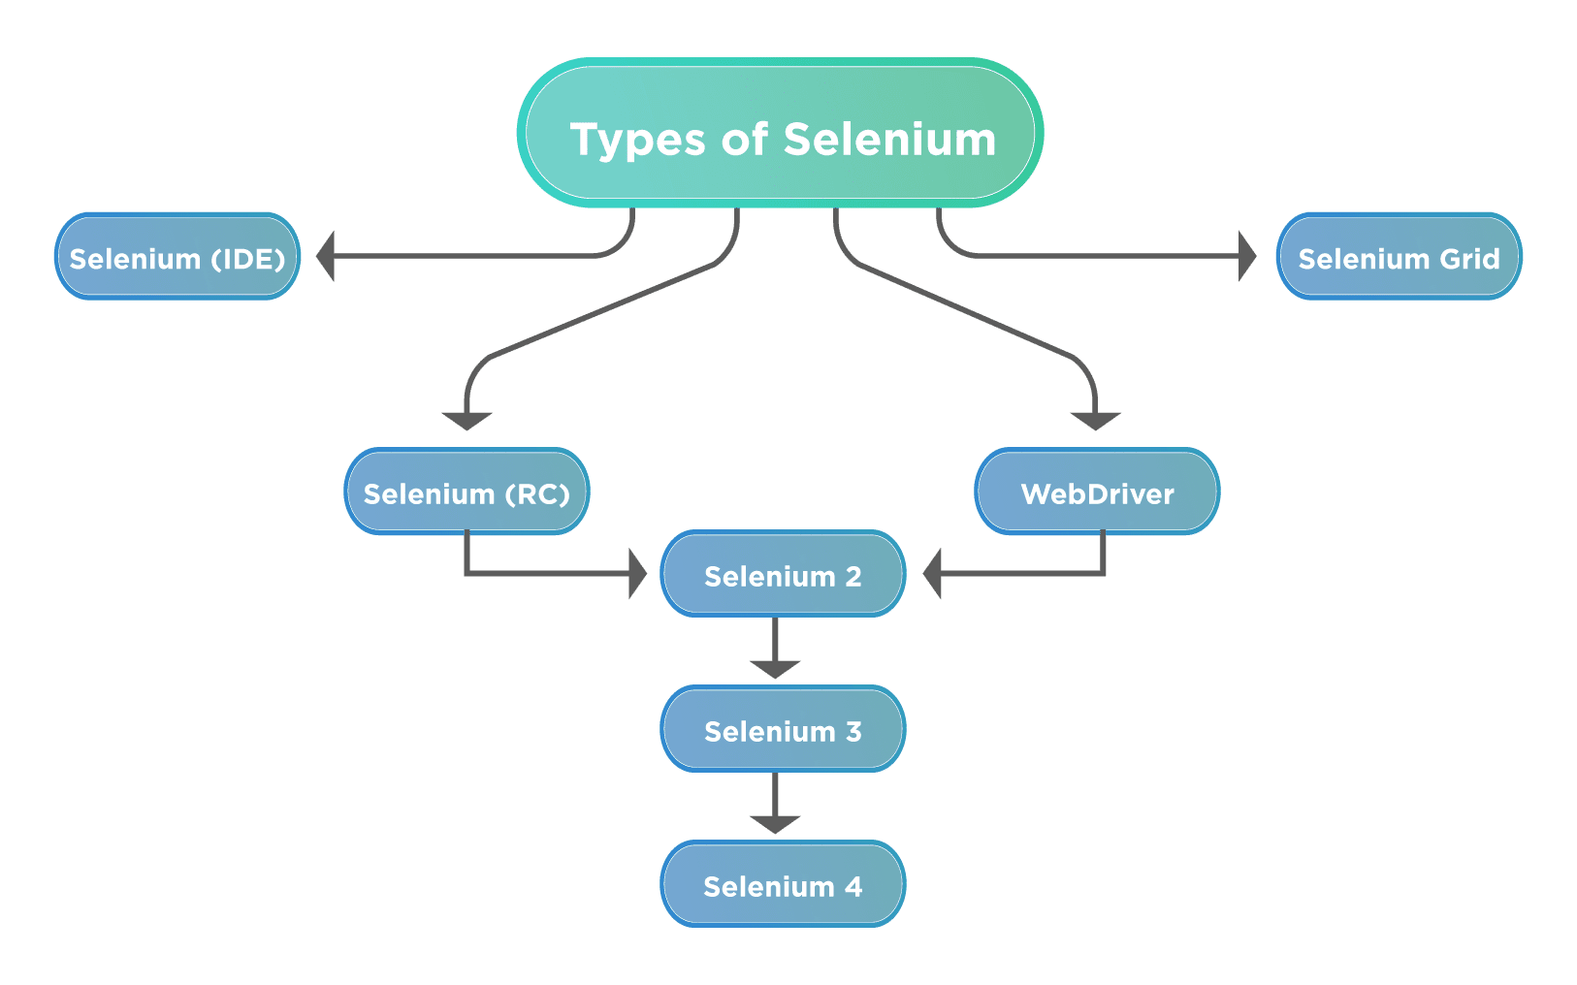
Automation Testing Tool : Selenium
Selenium is a free (open-source) automated testing framework used to validate web applications across different browsers and platforms.
components of Selenium

Slide 5
What Selenium can do
A great solution for automation testing
Simulate user actions
Functional testing
Create regression tests to verify functionality and user acceptance.
Browser compatibility testing
The same script can run on any Selenium platform
Load testing
Stress testing

Slide 6
Selenium WebDriver
WebDriver is designed to providing a simpler and uniformed programming interface
Same WebDriver script runs for different platforms
interact with the browser of their choice, through browser-specific drivers.
Works on the OS level and uses a Protocol called JSONWireProtocol to communicate with browsers.
Support multiple programming language:
Java, C#, Python, Ruby, PHP, Perl…
Supports multiple browsers in multiple platforms
Google Chrome,Internet Explorer,Firefox,Opera,Safari, Chromium

Slide 7
How to use Selenium WebDriver
(1) Go to a page
(2) Locate an element
(3) Do something with that element......
(i) Locate an element
(i+1) Do something with that element
(i+2) Verify / Assert the result

Slide 8
Setup and instantiate Webdriver
Setup
Download the WebDriver java client zip from the official Selenium website.
Extract the files to Selenium Java folder.
Right-click on the Eclipse project > Build Path > Configure Build Path
Add the “Selenium WebDriver ” folder dependencies as “External JARs“ to the Project
Instantiate
import org.openqa.selenium.WebDriver;
import org.openqa.selenium.chrome.ChromeDriver;
System.setProperty("webdriver.chrome.driver", "Chrome Driver executable location on your system");
WebDriver driver = new ChromeDriver();

Slide 9
Sample Test case Automation
Verify the page title contains Empower

Slide 10
Sample Test case Automation
Verify the page title Steps
Open Web Browser
Launch the Application URL
Get the Web page title
Verify with Given text Empower
System.setProperty("webdriver.chrome.driver", "C:\\\\webdev\\\\chromedriver_88.exe");
WebDriver driver = new ChromeDriver();
driver.get("https://proj8-plan.empower-retirement.com/planweb/#/login/?accu=PlanEmpowerCR");
String pageTitle=driver.getTitle();
if(pageTitle.equals("Empower"))
System.out.println("Empower test is Available in Title");
else
System.out.println("Empower test is Not Available in Title");

Slide 11
Sample Test case Automation
import java.util.List;
import org.openqa.selenium.WebDriver;
import org.openqa.selenium.WebElement;
import org.openqa.selenium.chrome.ChromeDriver;
public class SeleniumTraining {
public static void main(String[] args) {
System.setProperty("webdriver.chrome.driver", "C:\\\\webdev\\\\chromedriver_88.exe");
WebDriver driver = new ChromeDriver();
driver.get("https://proj8-plan.empower-retirement.com/planweb/#/login/?accu=PlanEmpowerCR");
String pageTitle=driver.getTitle();
if(pageTitle.contains("Empower"))
System.out.println("Empower test is Available in Title");
else
System.out.println("Empower test is Not Available in Title");
}
}

Slide 12
Browser Actions
get(String arg0): void – This method Load a new web page in the current browser window. Accepts String as a parameter and returns nothing.
Command – driver.get(appUrl);
getTitle(): String – This method fetches the Title of the current page. Accepts nothing as a parameter and returns a String value.
Command – driver.getTitle();
getCurrentUrl(): String – This method fetches the string representing the Current URL which is opened in the browser. Accepts nothing as a parameter and returns a String value.
Command – driver.getCurrentUrl();
getPageSource(): String – This method returns the Source Code of the page. Accepts nothing as a parameter and returns a String value.
Command – driver.getPageSource();
close(): void – This method Close only the current window the WebDriver is currently controlling. Accepts nothing as a parameter and returns nothing.
Command – driver.close();
quit(): void – This method Closes all windows opened by the WebDriver. Accepts nothing as a parameter and returns nothing.
Command – driver.quit();

Slide 13
Navigation Actions
to(String arg0) : void – This method Loads a new web page in the current browser window. It accepts a String parameter and returns nothing.
Command – driver.navigate().to(appUrl);
forward() : void – This method does the same operation as clicking on the Forward Button of any browser. It neither accepts nor returns anything.
Command – driver.navigate().forward();
back() : void – This method does the same operation as clicking on the Back Button of any browser. It neither accepts nor returns anything.
Command – driver.navigate().back();
refresh() : void – This method Refresh the current page. It neither accepts nor returns anything.
Command – driver.navigate().refresh();

Slide 14
WebElement Actions
Clear Command
clear( ) : void – If this element is a text entry element, this will clear the value. This method accepts nothing as a parameter and returns nothing.
Command – element.clear();
Click Command
click( ) : void – This simulates the clicking of any element. Accepts nothing as a parameter and returns nothing.
Command – element.click();
SendKeys Command
sendKeys(CharSequence… keysToSend ) : void – This simulates typing into an element, which may set its value. This method accepts CharSequence as a parameter and returns nothing.
Command – element.sendKeys(“text”);
IsDisplayed Command
isDisplayed( ) : boolean – This method determines if an element is currently being displayed or not. This accepts nothing as a parameter but returns a boolean value(true/false).
Command – element.isDisplayed();

Slide 15
WebElement Actions continued..
IsEnabled Command
isEnabled( ) : boolean – This determines if the element currently is Enabled or not? This accepts nothing as a parameter but returns boolean value(true/false).
Command – element.isEnabled();
IsSelected Command
isSelected( ) : boolean – Determine whether or not this element is selected or not. This accepts nothing as a parameter but returns boolean value(true/false).
Command – element.isSelected();
Submit Command
submit( ) : void– This method works well/better than the click() if the current element is a form, or an element within a form. This accepts nothing as a parameter and returns nothing.
Command – element.submit();
GetText Command
getText( ) : String– This method will fetch the visible (i.e. not hidden by CSS) innerText of the element. This accepts nothing as a parameter but returns a String value.
Command – element.getText();

Slide 16
WebElement Actions continued..
getTagName Command
getTagName( ) : String– This method gets the tag name of this element. This accepts nothing as a parameter and returns a String value.
Command – element.getTagName();
getSize Command
getSize( ) : Dimension – This method fetch the width and height of the rendered element. This accepts nothing as a parameter but returns the Dimension object.
Command – element.getSize();
getLocation Command
getLocation( ) : Point – This method locate the location of the element on the page. This accepts nothing as a parameter but returns the Point object.
Command – element.getLocation();

Slide 17
Find elements in Selenium
Selenium WebDriver provides two methods using which we can find an element or list of elements on a web page.
findElement(): This method uniquely finds a web element on the web page.
Syntax :
WebElement elementName= driver.findElement (By.LocatorStrategy("LocatorValue"));
findElements(): This method finds a list of web elements on the web page.
Syntax :
List<WebElement> elementName = driver.findElements(By.LocatorStrategy("LocatorValue"));
Notes:
findElement() method of the Selenium WebDriver finds a unique web element within the webpage.
findElements() returns a list of web elements that match the specified criteria, unlike findElement() which returned a unique element. If there are no matching elements then an empty list returns.
command accepts the “By ” object as the argument and returns a WebElement object.
The “By” is a locator or query object and accepts the locator specifier or strategies we discussed above. So if we write the line “driver.findElement ( By.)

Slide 18
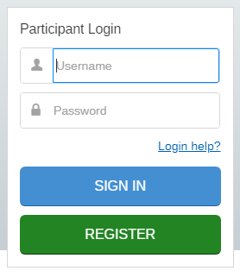
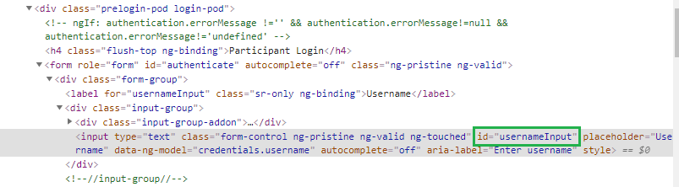
Select Elements By ID
Finding an element using the attribute “id”.
Syntax :
WebElement element = driver.findElement(By.id("<id>"));
Example :
WebDriver driver = new ChromeDriver();
driver.get("https://participant.empower-retirement.com/participant/#/login");
String IdValue = "usernameInput";
WebElement username = driver.findElement(By.id(IdValue));
if (username != null)
System.out.println("Username Element found ");
else
System.out.println("Username Element not found ");

Slide 19
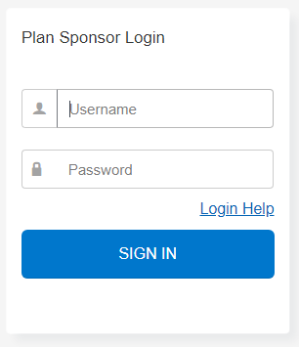
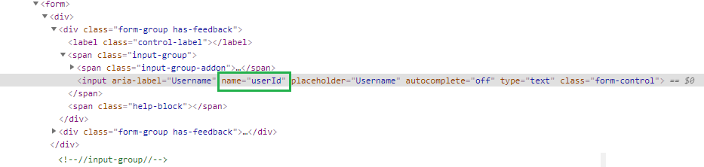
Select Elements By Name
Finding an element using the attribute “name”.
Syntax :
WebElement element = browser.findElement(By.name("<name>"));
Example :
WebDriver driver = new ChromeDriver(options);
driver.get("https://proj8-plan.empower-retirement.com/planweb/#/login/?accu=PlanEmpowerCR");
String nameValue = "userId";
WebElement name = driver.findElement(By.name(nameValue));
if (name != null)
System.out.println("Username Element found ");
else
System.out.println("Username Element not found ");

Slide 20
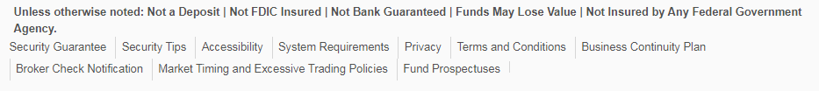
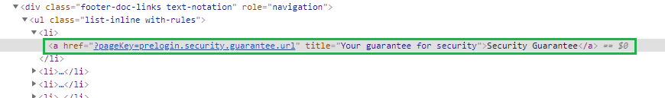
Select Elements By Link Text
Finding an element using LinkText.
Syntax :
WebElement element = driver.findElement(By. linkText("<LinkText>"));
Example :
WebDriver driver = new ChromeDriver();
driver.get("https://proj8-plan.empower-retirement.com/planweb/#/login/?accu=PlanEmpowerCR");
WebElement Link = driver.findElement(By.linkText("Security Guarantee"));
Link.click();

Slide 21
Select Elements By Partial Link Text
Finding an element using Partial LinkText.
Syntax :
WebElement element = driver.findElement(By. partialLinkText("< partialLinkText >"));
Example :
WebDriver driver = new ChromeDriver(options);
driver.get("https://proj8-plan.empower-retirement.com/planweb/#/login/?accu=PlanEmpowerCR");
WebElement Link = driver.findElement(By.partialLinkText("Guarantee"));
Link.click();

Slide 22
Select Elements By Xpath
Finding an element using the locator “xpath”.
Syntax :
WebElement element = driver.findElement(By.xpath("<xpath>"));
Example :
WebDriver driver = new ChromeDriver(options);
driver.get("https://proj8-plan.empower-retirement.com/planweb/#/login/?accu=PlanEmpowerCR");
String xpath = "//input[@name='userId']";
WebElement name = driver.findElement(By.xpath(xpath));
if (name != null)
System.out.println("Username Element found ");
else
System.out.println("Username Element not found ");

Slide 23
Finding Multiple Elements
Find the multiple elements with the help of findlements method
Syntax :
List<WebElement> elementName = driver.findElements(By.LocatorStrategy("LocatorValue"));
Example:
WebDriver driver = new ChromeDriver(options);
driver.get("https://proj8-plan.empower-retirement.com/planweb/#/login/?accu=PlanEmpowerCR");
String xpath = "//a";
List<WebElement> links= driver.findElements(By.xpath(xpath));
System.out.println("Number of links in the page "+links.size());

Slide 24
Working with WebElements

Slide 25
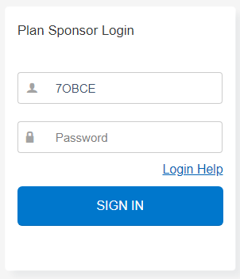
Working with Elements : Text Box
WebDriver driver = new ChromeDriver(options);
driver.get("https://proj8-plan.empower-retirement.com/planweb/#/login/?accu=PlanEmpowerCR");
String nameValue = "userId";
WebElement name = driver.findElement(By.name(nameValue));
name.clear();
name.sendKeys("7OBCE");

Slide 26
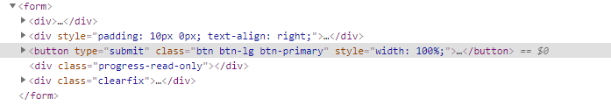
Working with Elements : Submit Button
WebDriver driver = new ChromeDriver(options);
driver.get("https://proj8-plan.empower-retirement.com/planweb/#/login/?accu=PlanEmpowerCR");
String nameValue = "userId";
WebElement name = driver.findElement(By.name(nameValue));
name.clear();
name.sendKeys("7OBCE");
WebElement submitButton= driver.findElement(By.id("submit"));
submitButton.click();

Slide 27
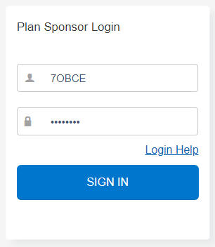
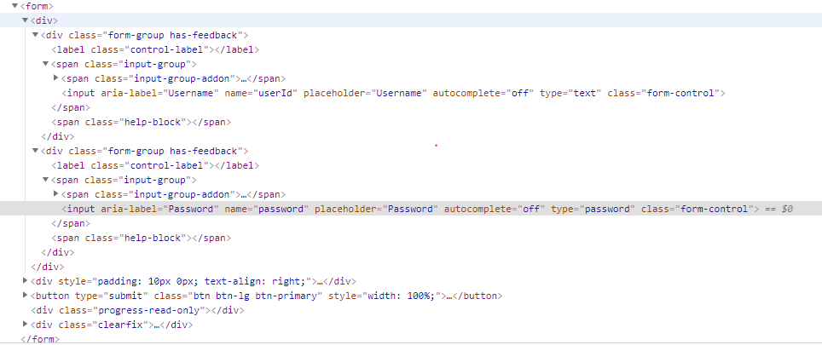
Working with Elements : Forms
WebDriver driver = new ChromeDriver(options);
driver.get("https://proj8-plan.empower-retirement.com/planweb/#/login/?accu=PlanEmpowerCR");
WebElement username = driver.findElement(By.name("userId"));
username.clear();
username.sendKeys("7OBCE");
WebElement password = driver.findElement(By.name("password"));
password.clear();
password.sendKeys(“testing1");
WebElement submitButton= driver.findElement(By.id("submit"));
submitButton.click();

Slide 28
Working with Elements : Link
WebDriver driver = new ChromeDriver(options);
driver.get("https://proj8-plan.empower-retirement.com/planweb/#/login/?accu=PlanEmpowerCR");
WebElement Link = driver.findElement(By.linkText("Security Guarantee"));
Link.click();

Slide 29
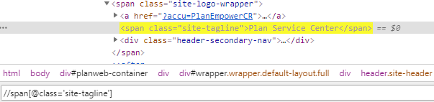
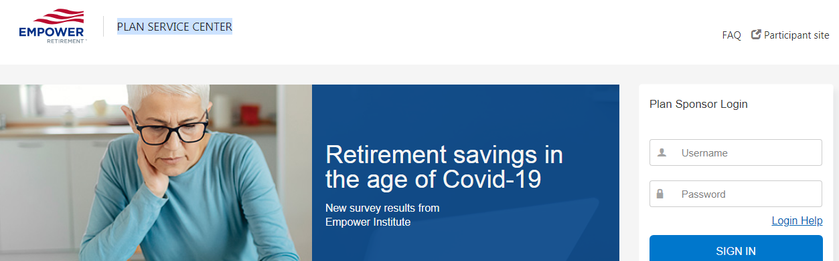
Working with Elements : Text
getText() returns the visible innerTextof the element, including sub-elements, but trimmed out.
WebDriver driver = new ChromeDriver(options);
driver.get("https://proj8-plan.empower-retirement.com/planweb/#/login/?accu=PlanEmpowerCR");
WebElement text = driver.findElement(By.xpath("//span[@class='site-tagline']"));
String name= text.getText().
if(name.equalsIgnoreCase("Plan Service Center"))
System.out.println("Text Element found");
else
System.out.println("Text Element not ound");

Slide 30
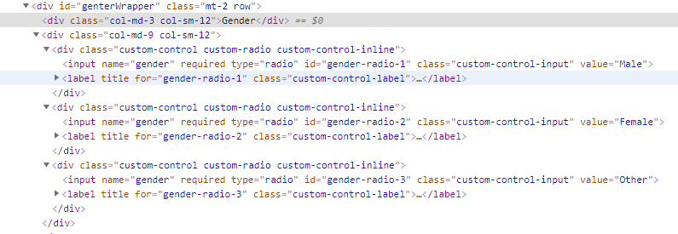
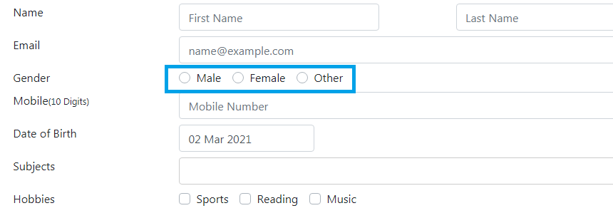
Working with Elements : Radio Button
WebElement male= driver.findElement(By.id("gender-readio-1"));
male.click();

Slide 31
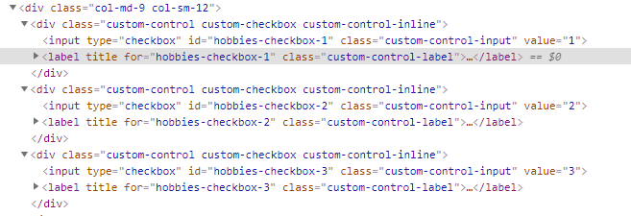
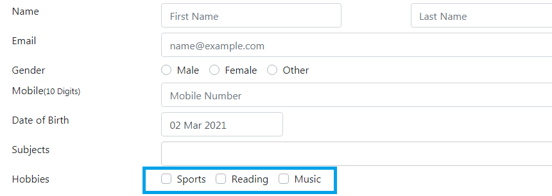
Working with Elements : Check Box
WebElement sports= driver.findElement(By.id("hobbies-checkbox-1"));
sports.click();
WebElement music= driver.findElement(By.id("hobbies-checkbox-3"));
music.click();
if(sports.isSelected()&& music.isSelected())
System.out.println("Sports and Music Selected ");

Slide 32
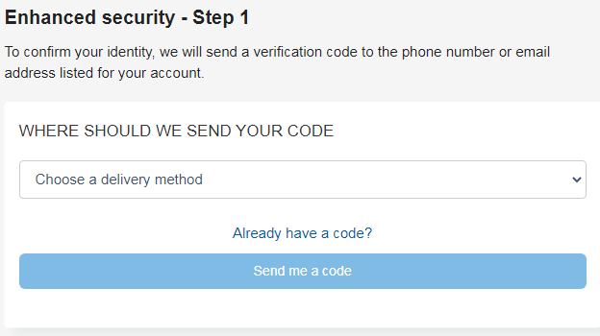
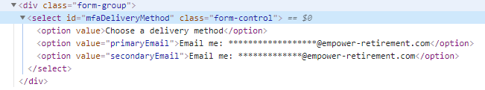
Working with Elements : DropDown
WebElement dropdown= driver.findElement(By.id("mfaDeliveryMethod"));
Select element=new Select(dropdown);
element.selectByIndex(1);
element.selectByVisibleText("Email me: ******************@empower-retirement.com");
element.selectByValue(("primaryEmail"));

Slide 33
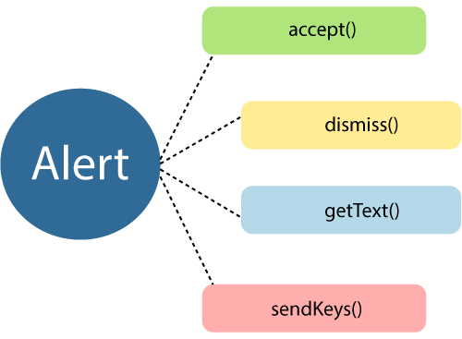
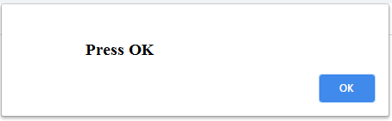
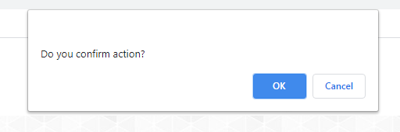
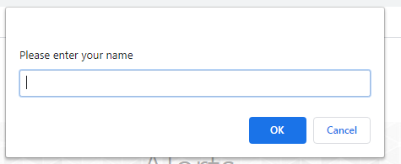
Alerts
Alerts are small popup boxes/windows which display the messages/notifications and notify the user with some information seeking some permission on certain kinds of operations.
Simple Alert
Confirmation Alerts
Prompt Alerts
Alert alert= driver.switchTo().alert();
alert.dismiss();
alert.accept();
alert.sendKeys("Hello");
alert.getText();

Slide 34
iFrames
iFrame is a HTML document embedded inside an HTML document.
Defined by an <iframe></iframe> tag in HTML.
move between iFrames we have to use the driver’s switchTo().frame command
switchTo.frame(int frameNumber): Pass the frame index.
switchTo.frame(string frameNameOrId): Pass the frame element Name or ID.
switchTo.frame(WebElement frameElement): Pass the frame web element.

Slide 35
Demo: Verify page title
public static void main( String[] args)
{
// Create a new instance of the Firefox driver
WebDriver driver = new FirefoxDriver();
// (1) Go to a page
driver.get("http://www.google.com");
// (2) Locate an element
WebElementelement = driver.findElement(By.name("q"));
// (3-1) Enter something to search for
element.sendKeys(“empower");
// (3-2) Now submit the form. // WebDriver will find the form for us from the element
element.submit();
// (3-3) Wait up to 10 seconds for a condition
WebDriverWaitwaiting = new WebDriverWait(driver, 10);
waiting.until( ExpectedConditions.presenceOfElementLocated( By.id("pnnext") ) );
// (4) Check the title of the page
if( driver.getTitle().equals(“empower-Google Search") )
System.out.println("PASS");
else
System.err.println("FAIL");
//Close the browser
driver.quit();
}

